Slide 1
Capturing and Transforming Phase-Based Materials Data: The Materials Data Curator
Carelyn Campbell¹, Alden Dima², Sharief Youssef², Philippe Dessauw², Guilaume Sousa Amaral², and Mary Brady²
¹Materials Science and Engineering Division, Materials Measurement Laboratory
²Software and System Division, Information Technology Laboratory
September 2, 2015
PRISMS Center Annual Workshop

Slide 2


NIST Data Collaborators
Information Systems Group Mary Brady, Alden Dima, Sharief Youssef, Guillaume Sousa-Amaral, Y.-S. Li-Baboud, Benjamin Long, , Philippe Dessauw, Pierre Savonitto
Thermodynamics and Kinetics Group Carrie Campbell, Ursula Kattner, Ben Burton, Chandler Becker, Francesca Tavazza, Zach Trautt, Andrew Reid, Shenyen Li, Yannick Congo
Thermodynamic Research Group Kenneth Kroenlein, Robert Chirico, Michel Frenkel, Vladimir Diky, Boris Wilthan, Chirs Munzy
Cell Systems Science Group TN Bhat and John Elliott
Kent State, Laura Bartolo
NU, Cate Brinson,
Richard Zhao

Slide 3
NIST Data Efforts
Collaborations
DSpace
CHiMaD
ASM International: Structural Data Demonstration Project
DOE/EERE Kinetics of Cast Mg Alloys
Journals collaboration
IMMI
Others under discussion
DATA CAPTURE
TRC: ThermoML Archive
Materials Data
Curator
WebFF- Repository
Data Dissemination
Knowledge Representation
(XML based)
NLP
Resource Registries
TRC: Guide
Data Capture
Interatomic Potential Repository
Semantic
Media Wiki
Meta data
Standards
Data Types
Workflow
Tools
Data Processing
Uncertainty Analysis
Bench marking activities (DFT)
Data Analytics
Data Mining Tools

Slide 4
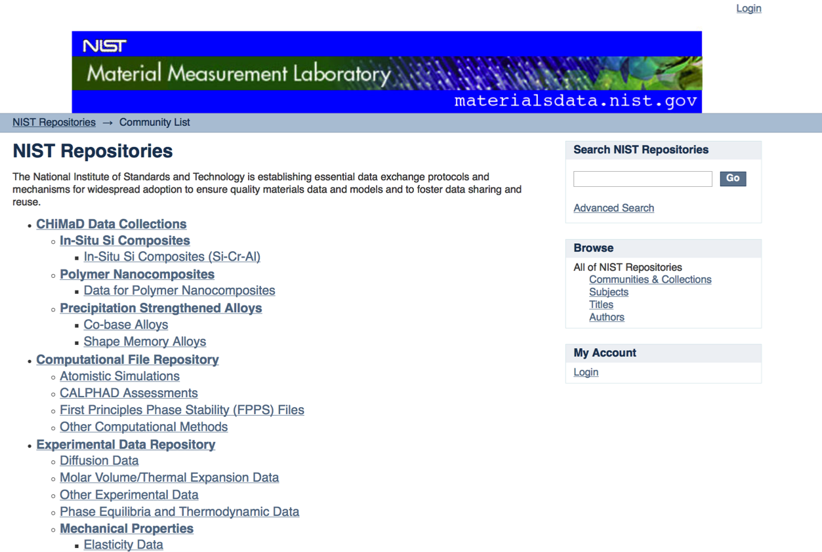
https://materialsdata.nist.gov/dspace/xmlui/
Customized DSpace repository for materials
Enables sharing of a variety of data types, including text, images, and video

Slide 5
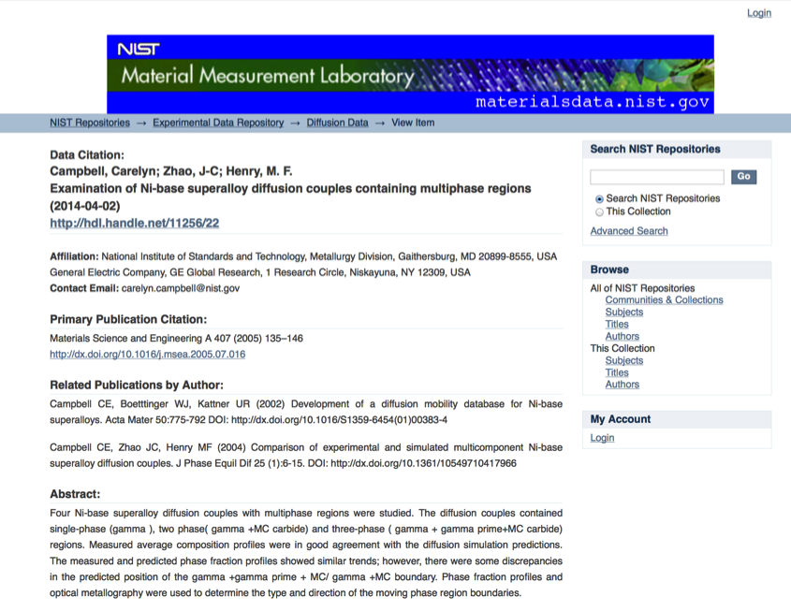
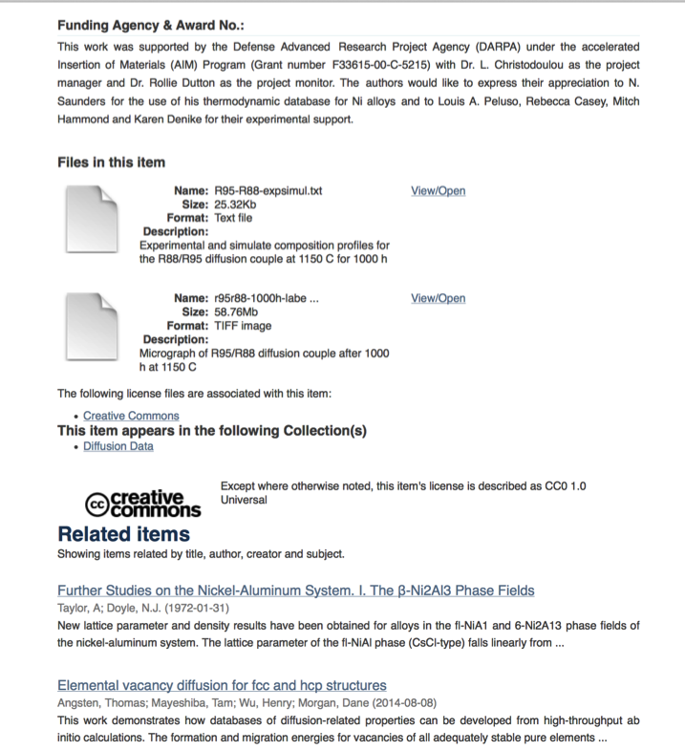

Digital Identifier
Data files
Related Work
Offer licenses with attribution 3.0
Notes:
Can limit access
- place embargos to delay until publication.
Customize submission process.

Slide 6
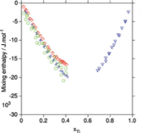
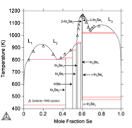
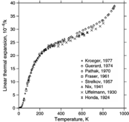
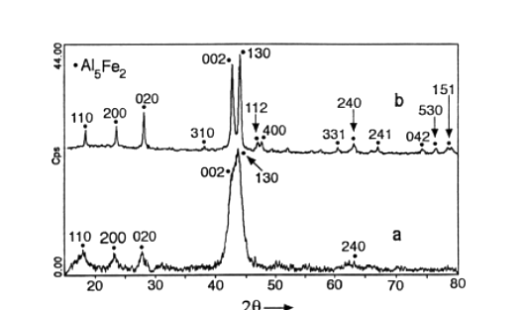
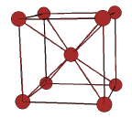
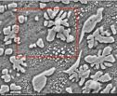
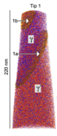
Examples of CALPHAD Data Types Data
For each assessment: Evaluated data file (e.g. POP, DOP)
Functional descriptions for phase quantity (e.g. TDB)
Emphasis on binary and ternary data to predict multicomponent properties
Data can be experimental or computational.
1-D (Points)
2-D (Lines)
Melting Temperatures
Composition
Profiles
Critical Temperatures
(Phase Changes)
Heat Capacities
Lattice Parameters
Enthalpies of mixing
3-D
Heat of Formations
Phase fractions and compositions
Tracer
Diffusivities
Crystal structures
Micrographs/Morphologies
Activation energies
3-D Atom probe Tomography

Slide 7



Example of Different Types of Data Users: Diffusion Data
Industry user just wants to the know the diffusion coefficient at given temperature for a given material.
Materials Data Infrastructure
D = 2.16e-15 m2/s
D= D₀ exp (-Q/RT)
Calphad user who wants to complete a new assessment
Diffusion Coefficients
Diffusion Couple Composition Profiles
Advanced expert wants to understand the diffusion mechanism
Composition Profiles
Raw Data (i.e Intensity vs Distance)
Need complete data sets
Data are diverse
Data are semi-structured

Slide 8
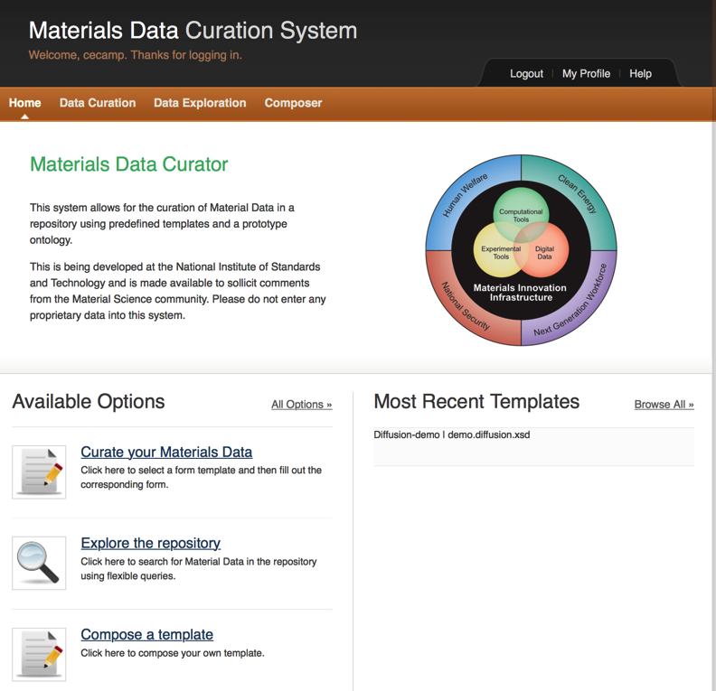
https://github.com/usnistgov/MDCS
Web-based Infrastructure
Python/Diango/MongoDB
REST API
XML-based
SPARQL queries
Template-based data management using XML-based forms and web APIs

Slide 9
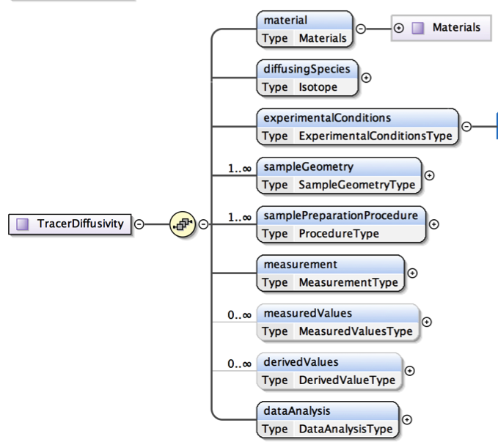


Why XML/XML-base Schema
XML: elemental syntax for content structure within documents
ThermoML – Thermochemical / Thermophysical Markup Language
CML – Chemical Markup Language
UnitsML – Units Markup Language
CIF – Crystallographic Information File
MatML – Materials Markup Language
MathML - Mathematical Markup Language
XML Based- Schemas :
User interface generated
dynamically from schema
Scalability
Customization/Modularity
Transformability into other formats

Slide 10
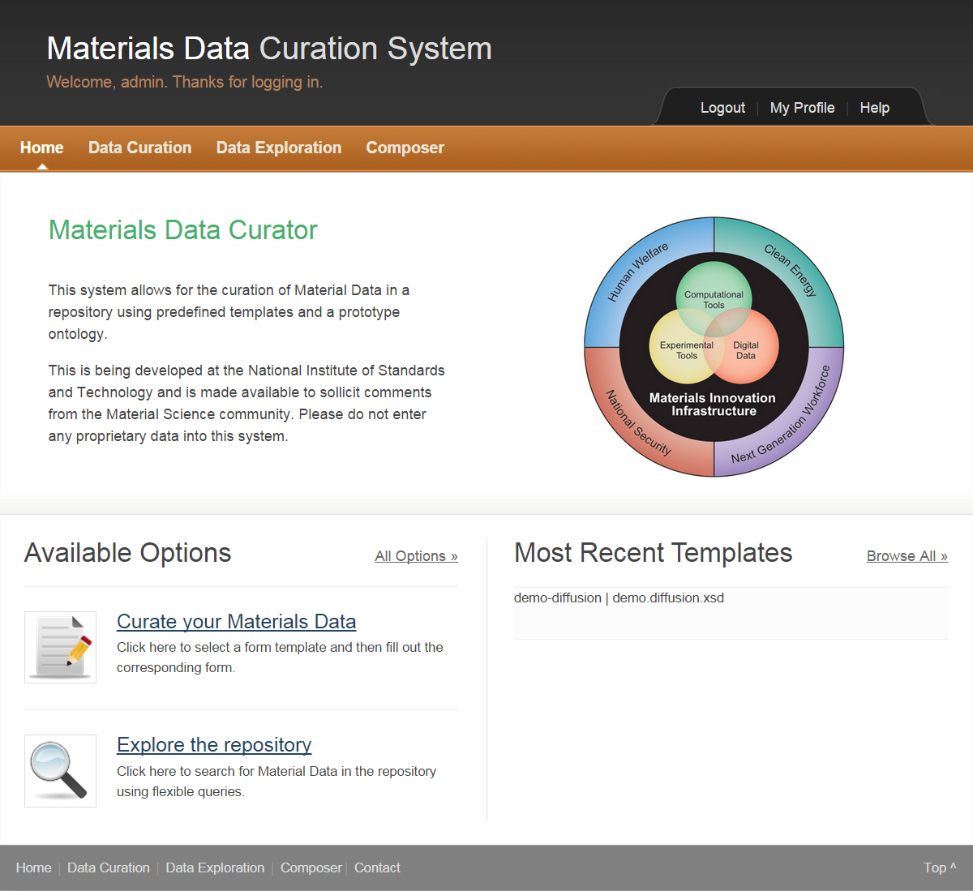
Exporter
Structural Elements
Data Curation
Data Exploration
Composer
Templates
Types
Administrative Dashboard
RESTful API
Exporter (under development)
POP, CSV, HTML, Script

Slide 11
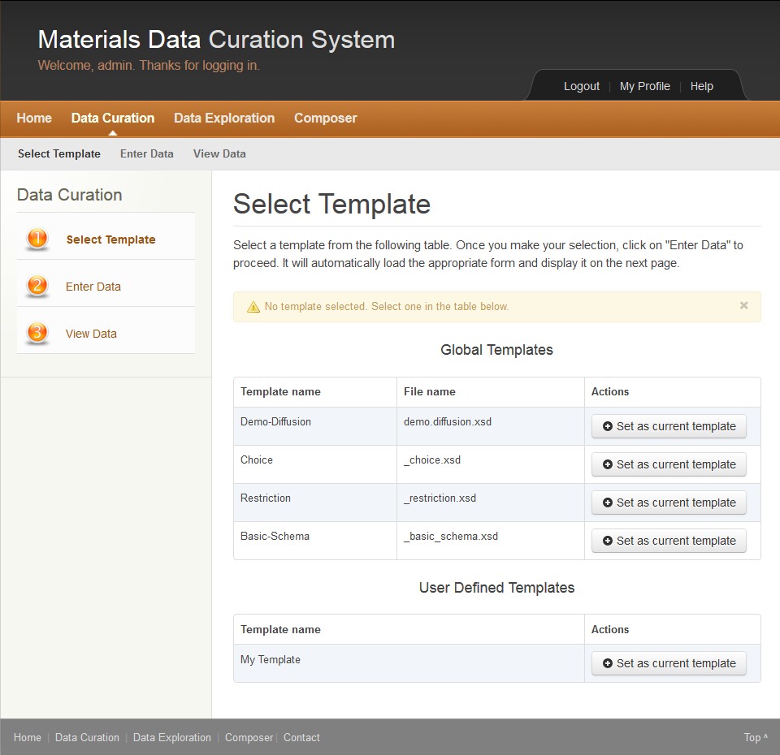
Data Curation Steps
Three Steps to Curate:
First: Select Template
Global Templates
User Defined Templates
Second: Enter Data
Third: View Data

Slide 12
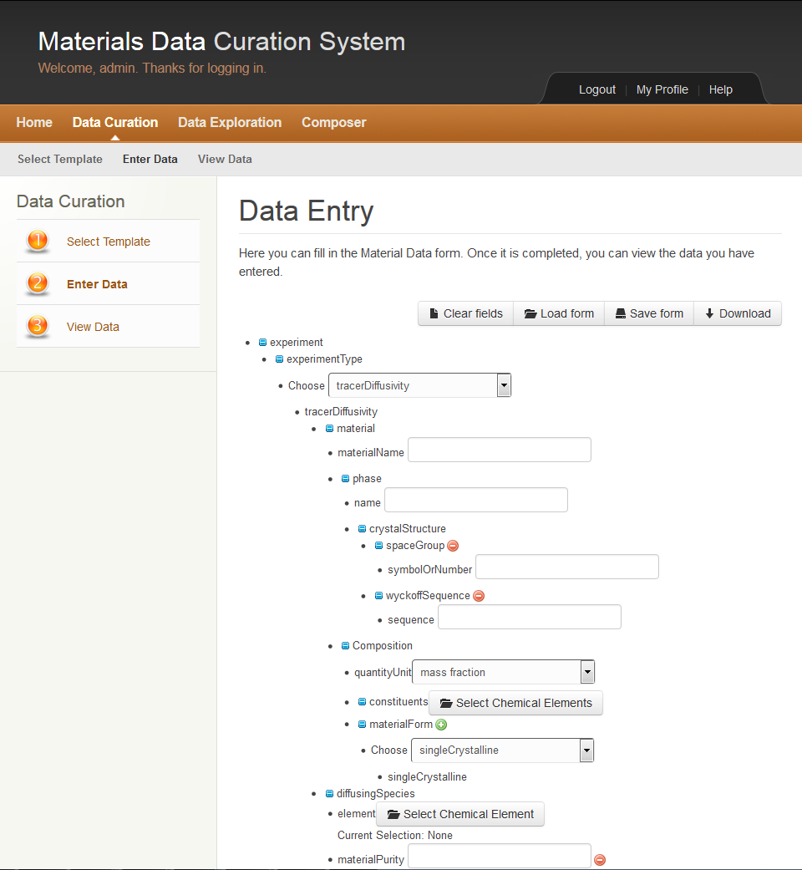
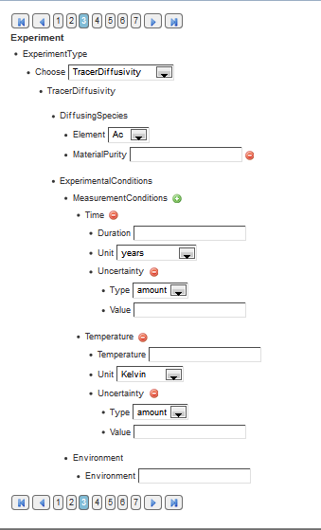
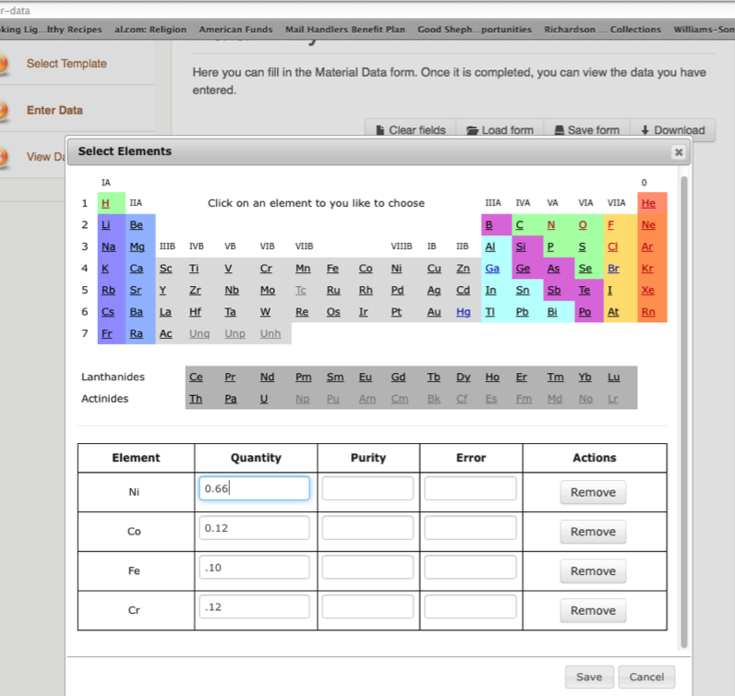
Data Curation: Tracer Diffusivity Test Schema
Three Steps to Curate:
First: Select Template
Global Templates
User Defined Templates
Second: Enter Data
HTML Generated
Based on Templates
Third: View Data

Slide 13
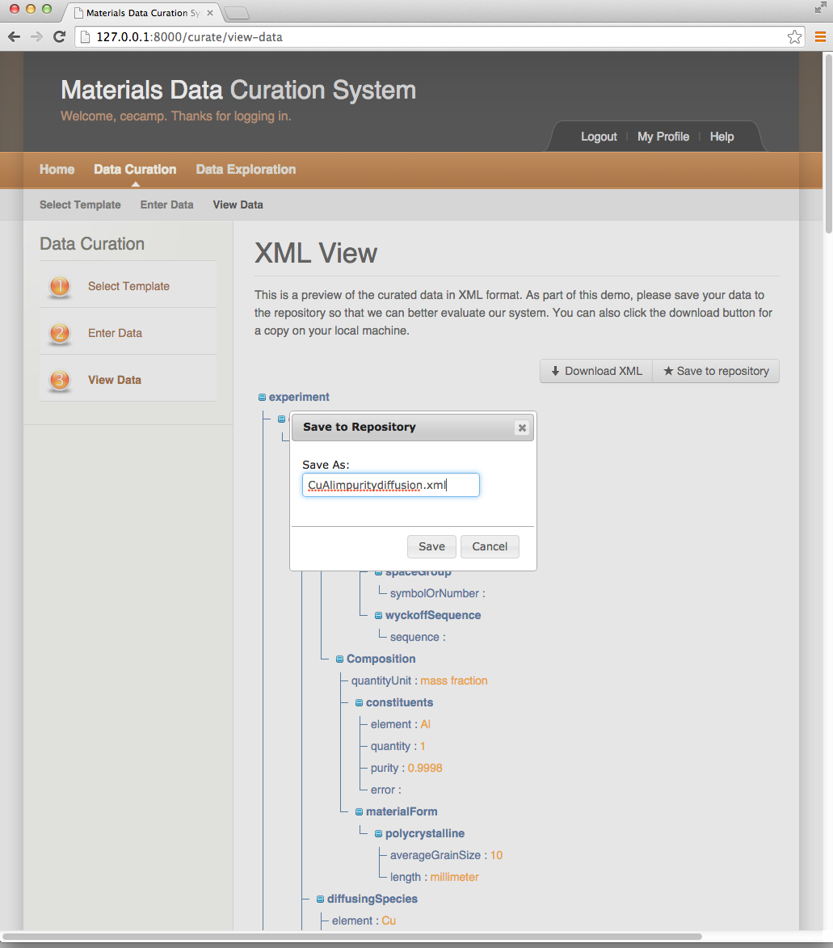
Data Curation : View Data
Three Steps to Curate:
Three Steps to Curate:
First: Select Template
Global Templates
User Defined Templates
Second: Enter Data
HTML Generateds
Based on Templates
Third: View Data
Requires Validation
Download in XML format
Can save to Repository

Slide 14
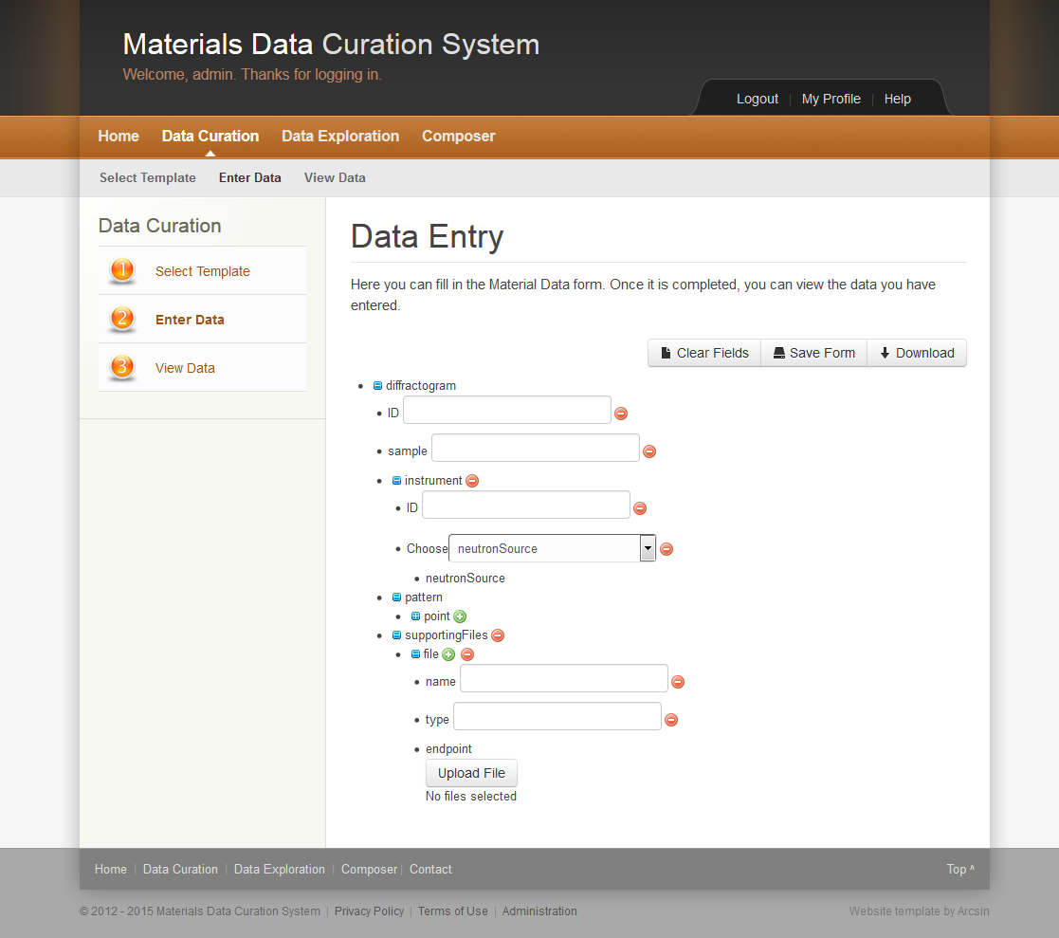
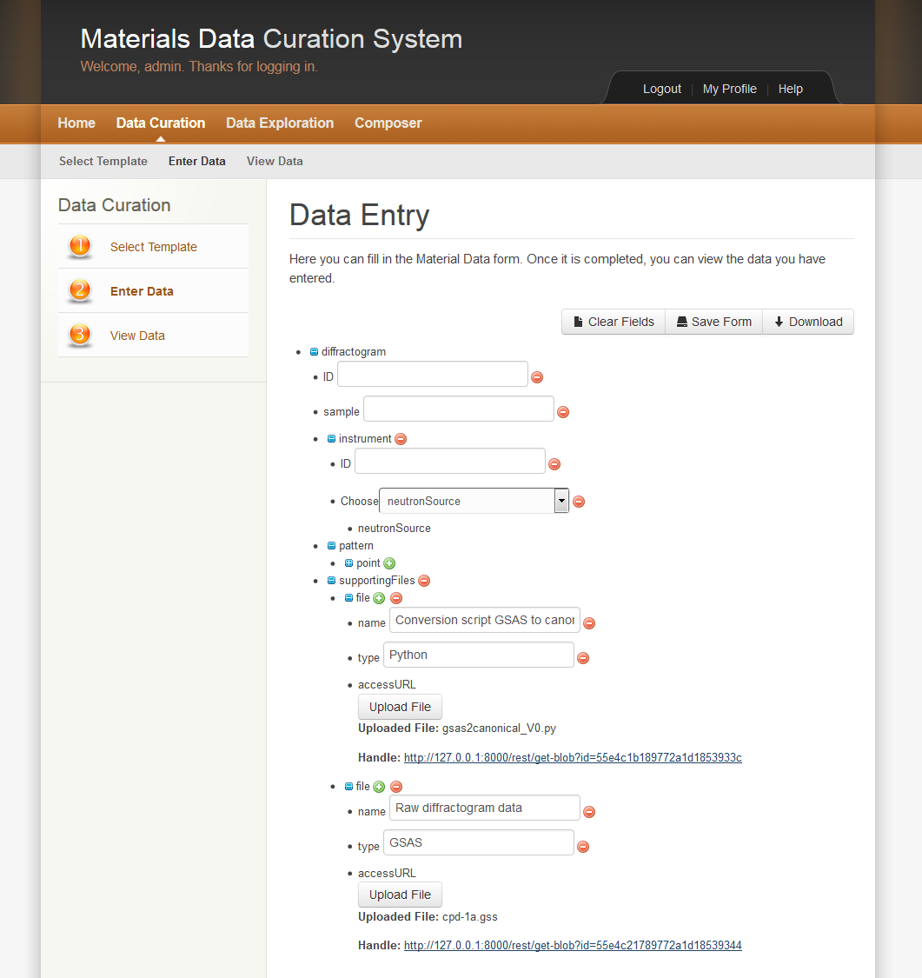
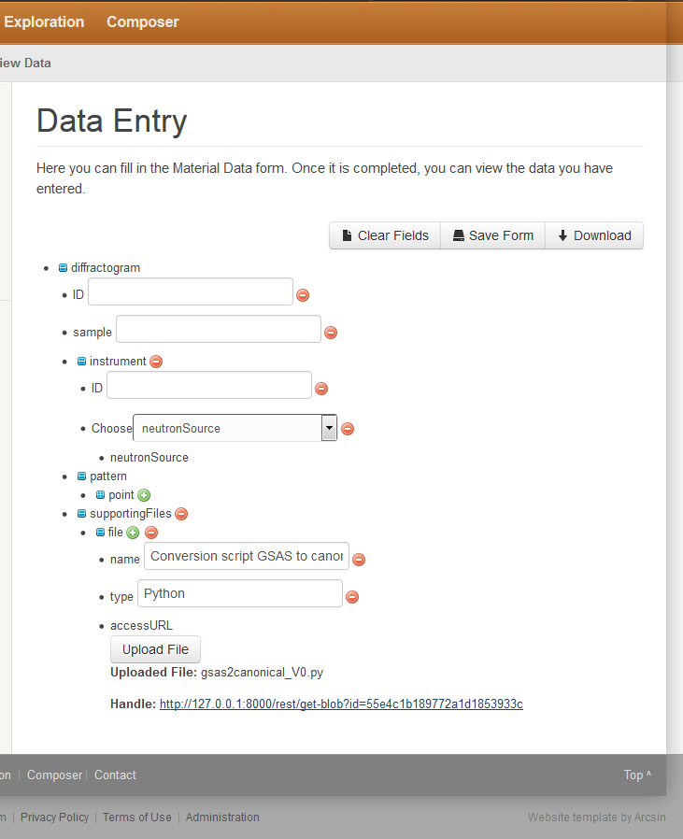
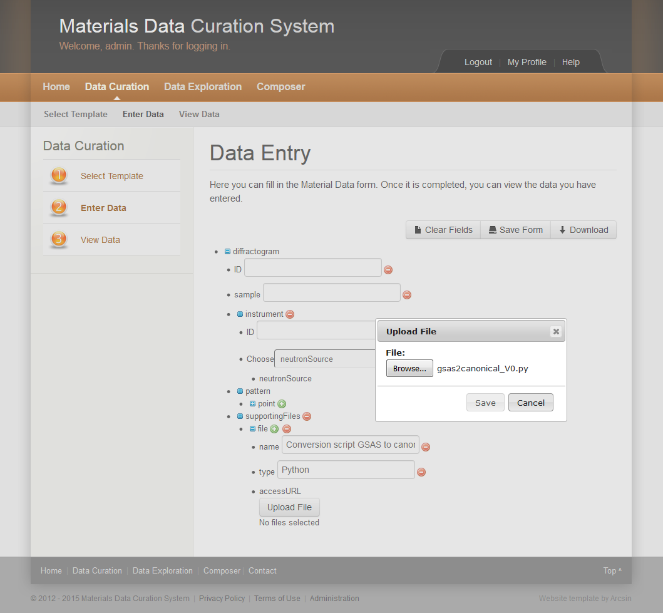
Data Curation: Large Data Files

Slide 15
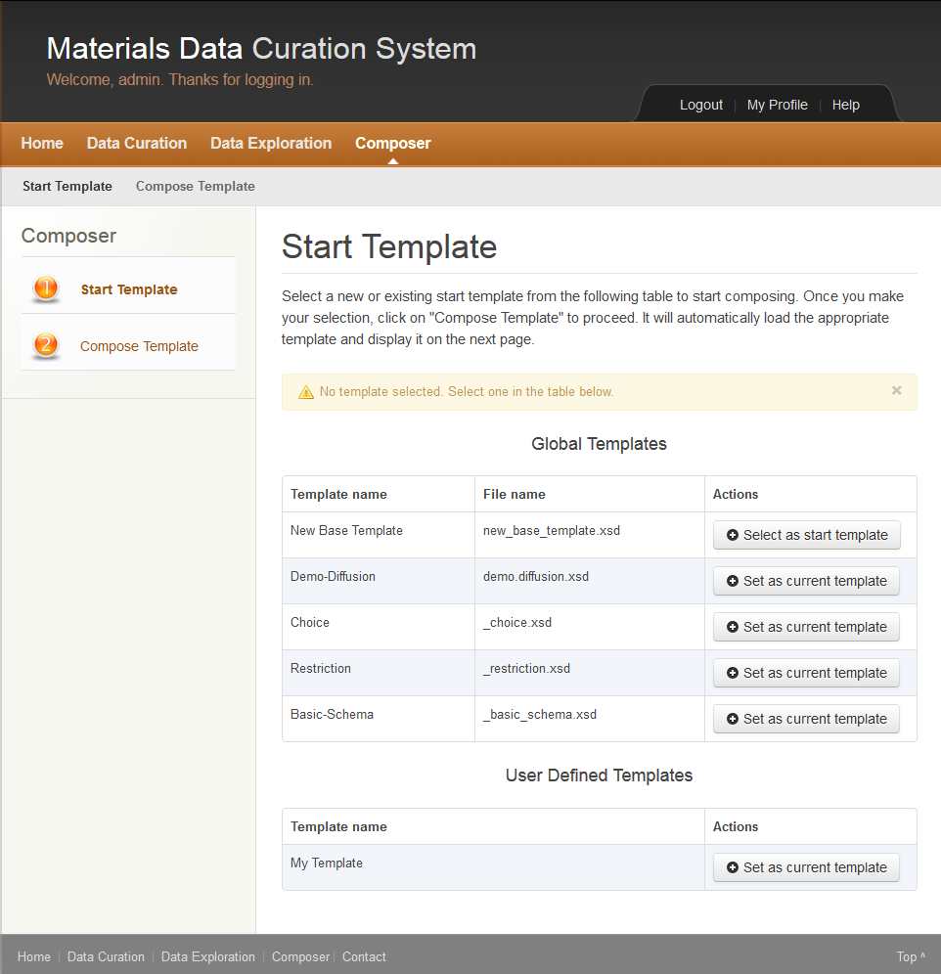
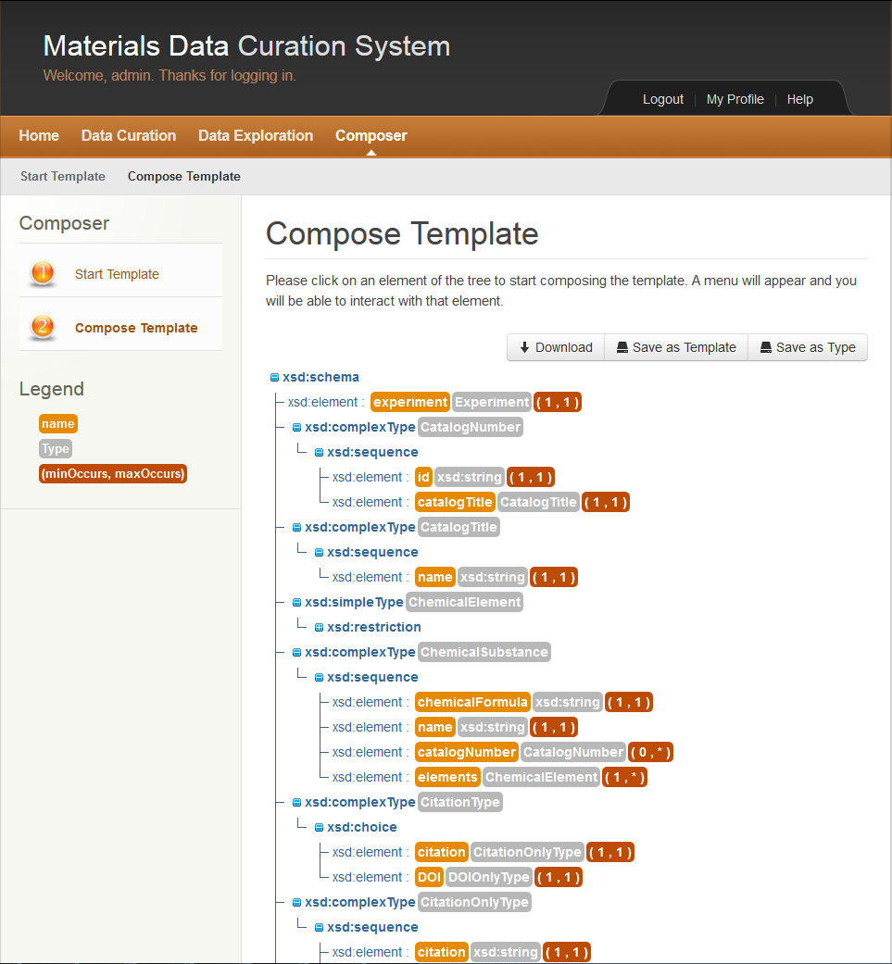
Composer
Two Steps to Compose:
Start Template
Global Templates
User Defined Templates
Compose
Based on Selected Template
Add/Delete Elements and Attributes
Save to a new User Defined Template

Slide 16
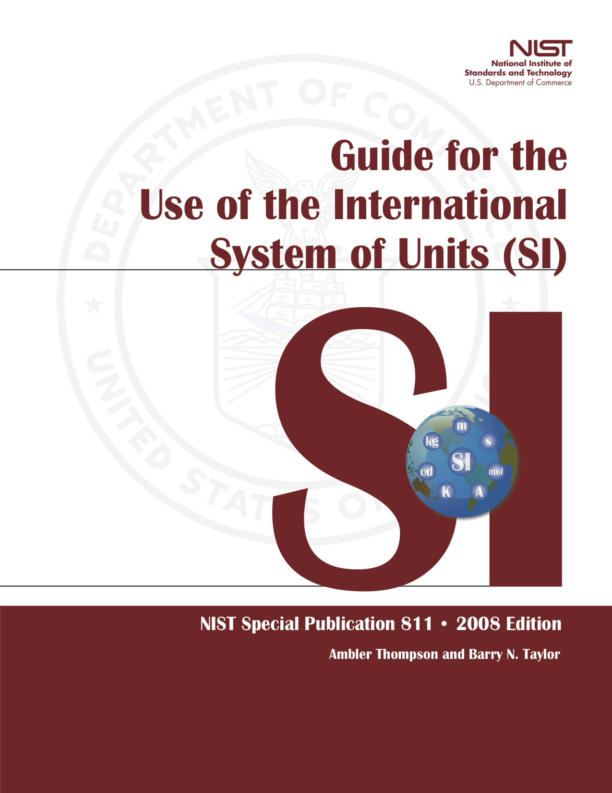
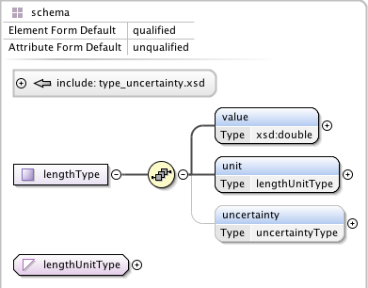
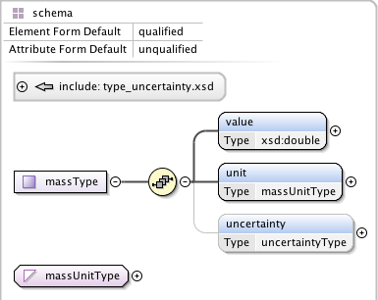
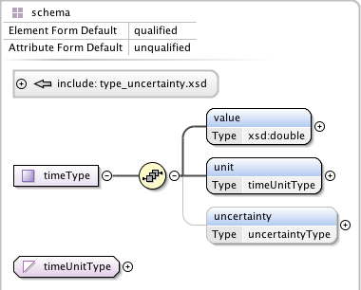
Physical Quantities: SP811
Zach Trautt, NIST

Slide 17
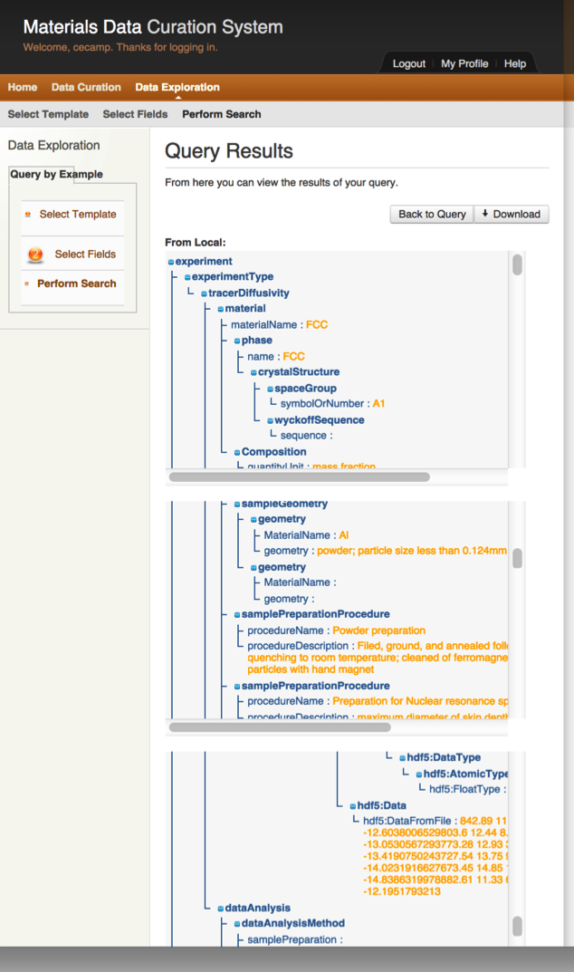
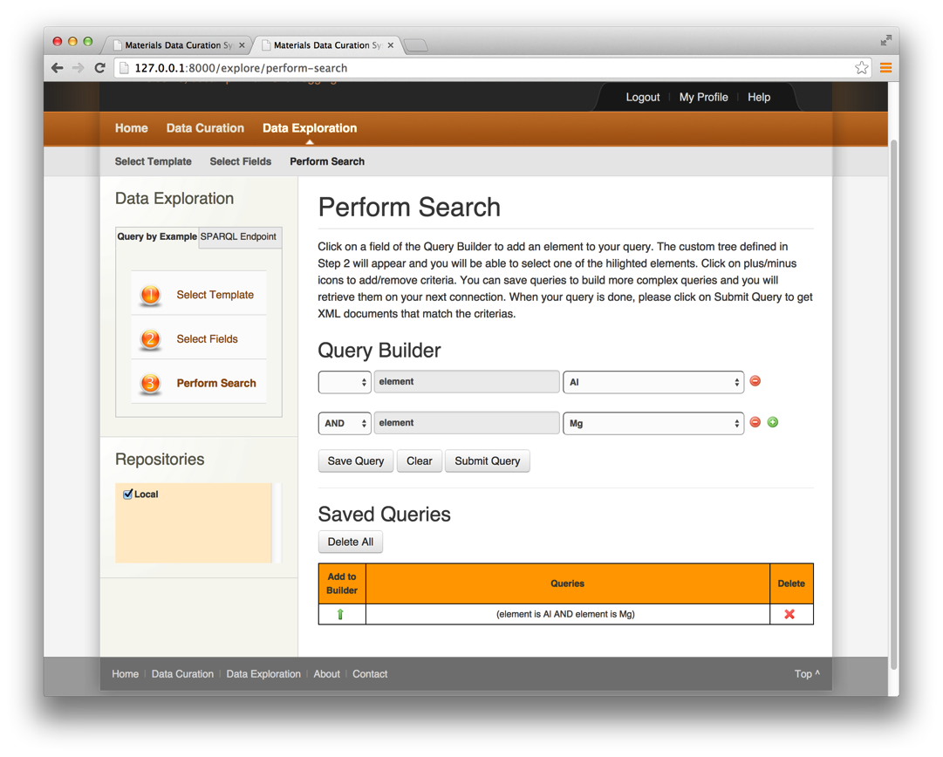
Data Exploration
Select Template
Select Fields
Specific fields to search against
Perform Search
Query By Example
SPARQL Queries

Slide 18
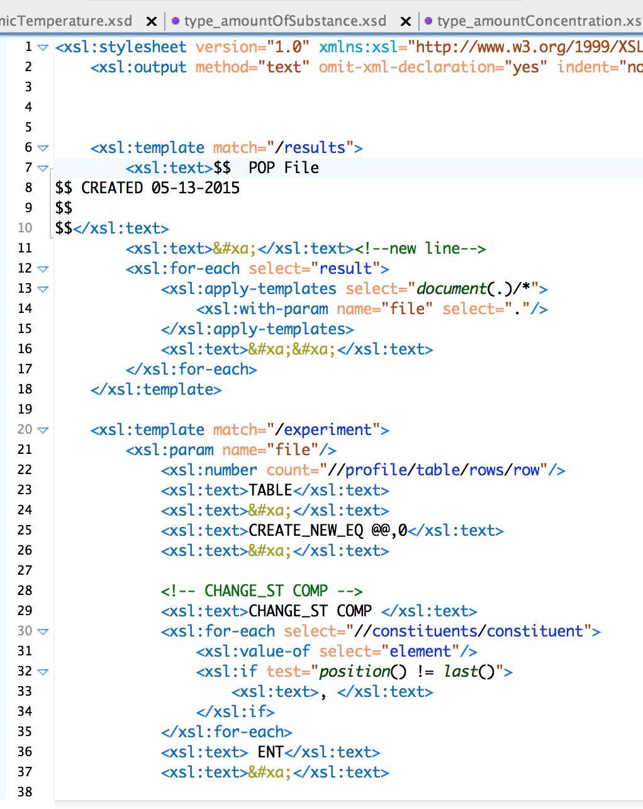
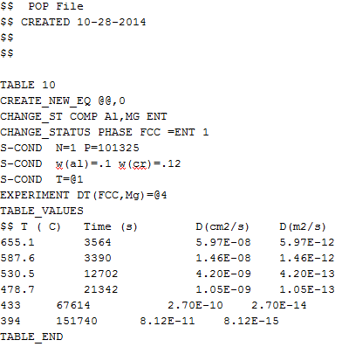
Exporter (Under Development): Using XSLT
Goal: Transform XML results to desired file types (POP, CSV, HTML, Script)
XML Results
XSLT
POP
XSLT = Extensible Language Stylesheet Transformations ; transform XML documents to other formats

Slide 19
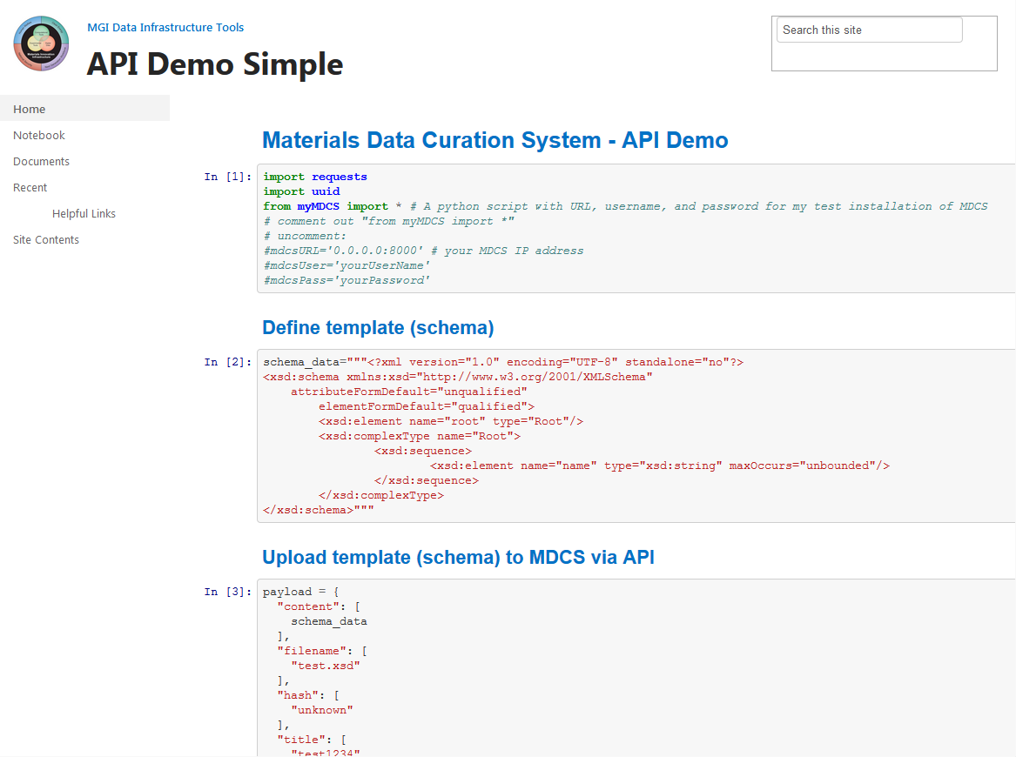
Current API Functions
Curate
Explore
Query by Example
SPARQL
Templates
Types
Saved Queries
Repositories
Users
Select
Select All
Add
Update
Delete
Restore
Versioning

Slide 20
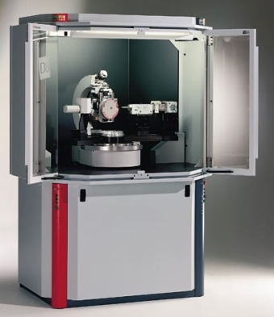

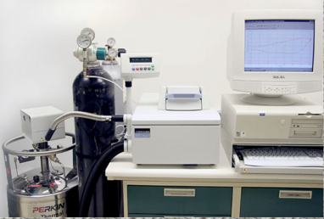

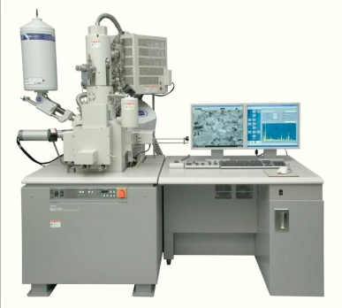
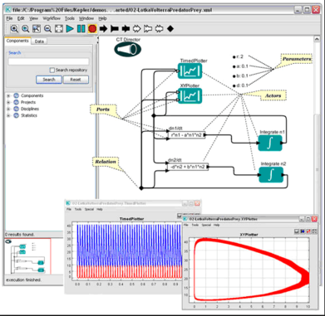
Materials Data Curation
Other Data/ Users
Data
User defined tools
Data to Share
Interface with workflow tools
Curated Data
(Data to share)
Interface with workflow tools
Send Data via API
Interface with workflow tools
Curation of Raw Data
Send Data via API
Send Data via AIP

Slide 21
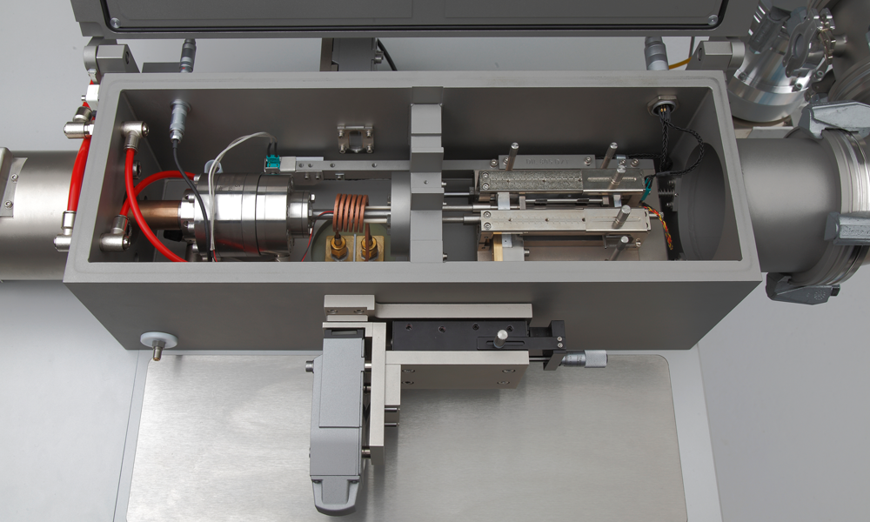
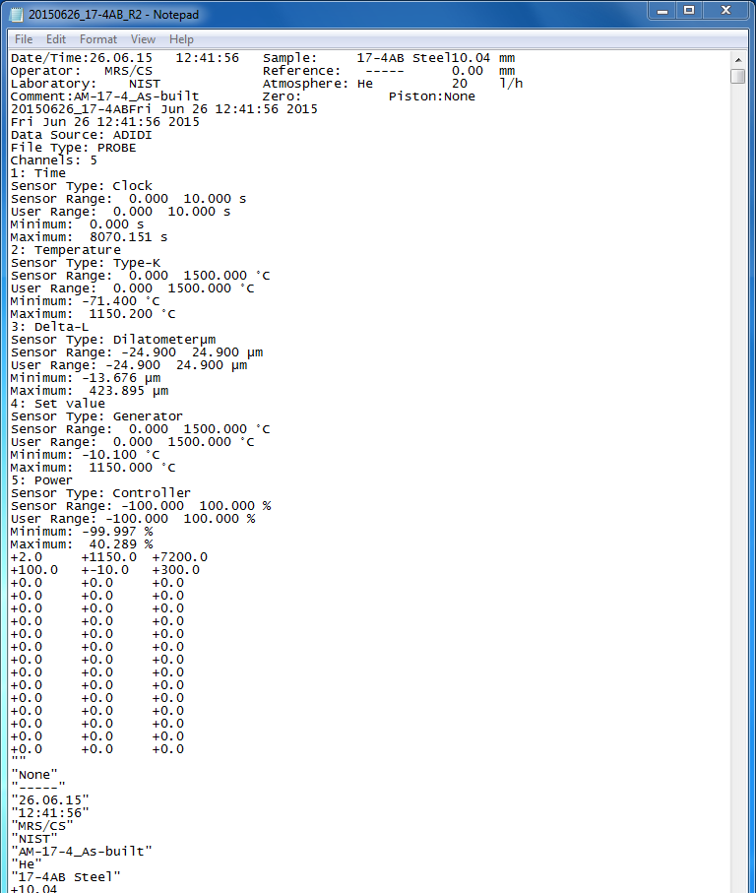
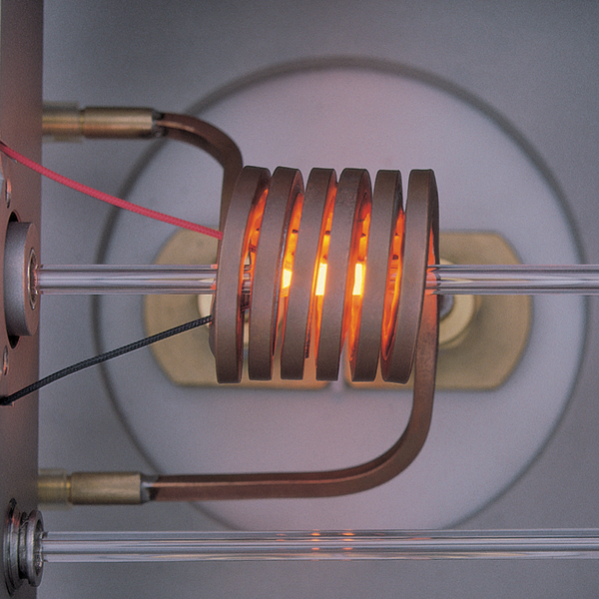
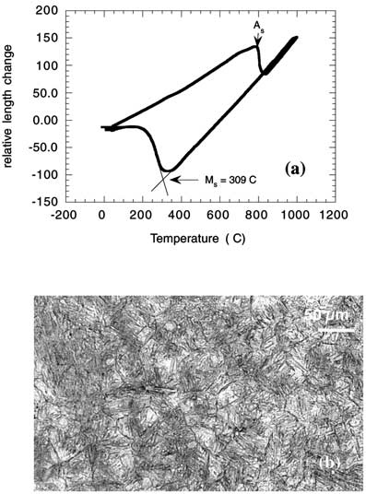
Dilatometer
Dilatometer Raw Data
Measured austenitic start and martensitic start temperatures for high strength stainless bearing steel
Raw Data from a dilatometer: Length vs Temperature
C. E. Campbell and G. B. Olson J. Computer-Aided-Materials Design. 7, 2001, 171.
http://www.linseis.com/en/our-products/dilatometer/
Notes:
Dilatomety is often use to measure when a phase change occurs (discontinuous change in length occurs at the temperature where the phase transformation occurs). Often used to generate continuous cooling curves and TTT diagrams (Time, Temperature, Transformation transformed)

Slide 22
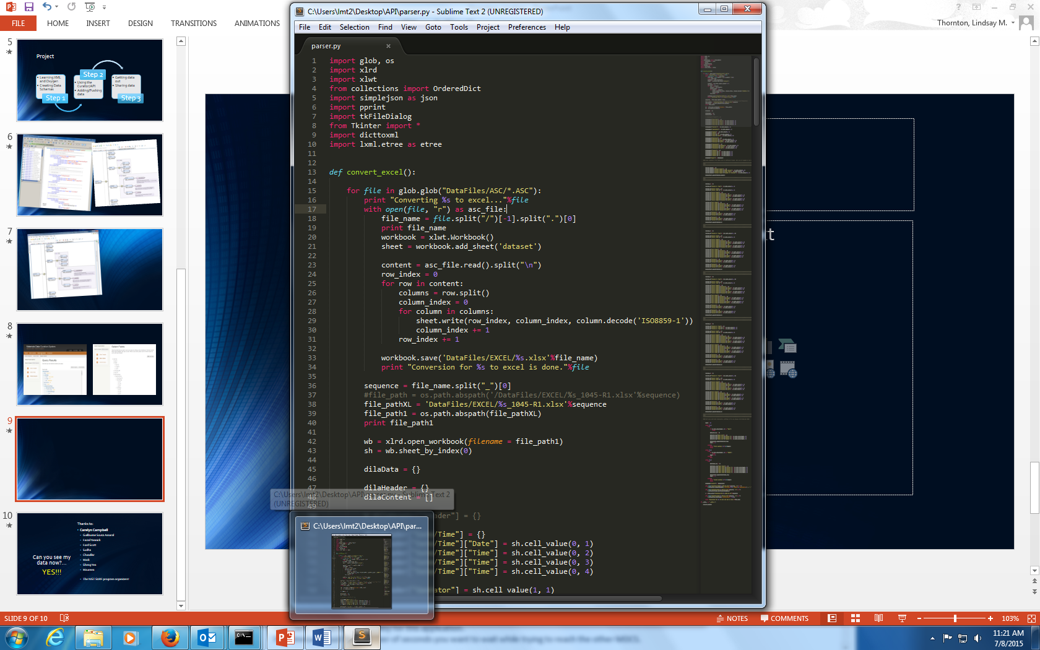
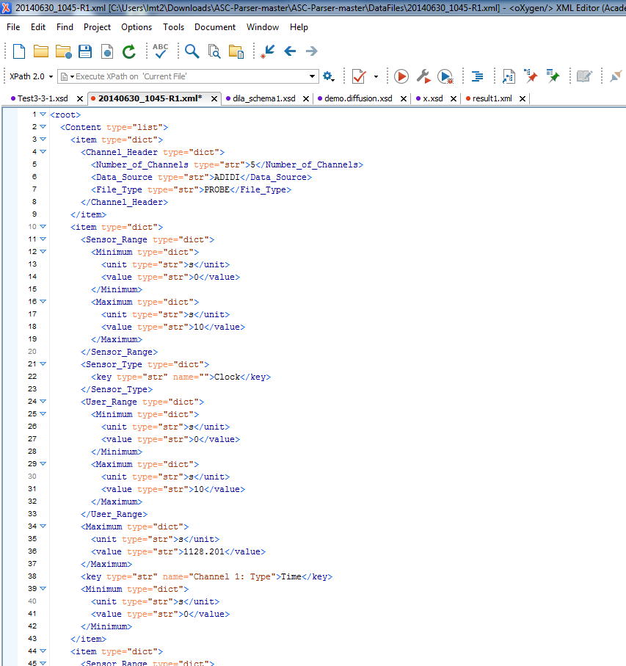
Python script to convert ASCII format to XML format
XML format

Slide 23
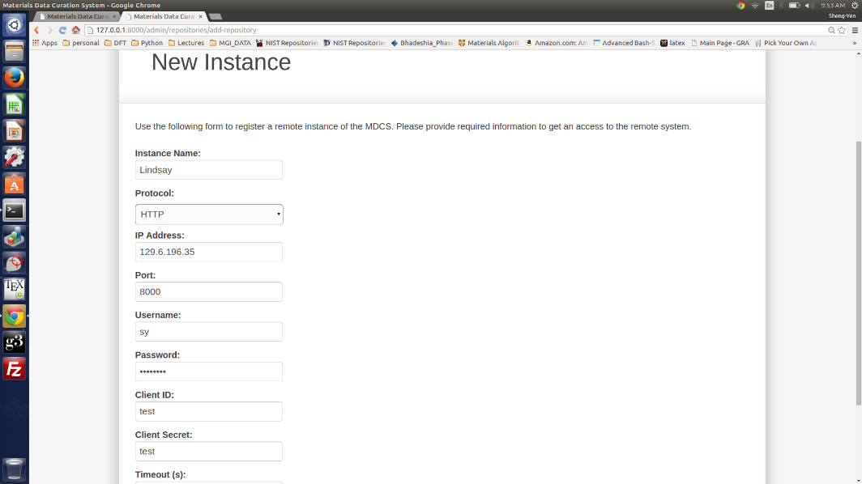
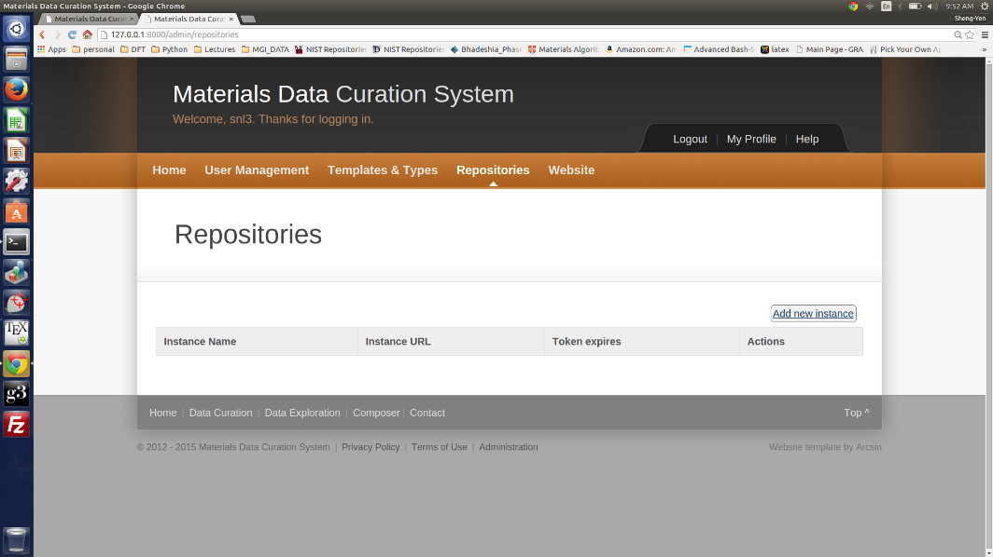
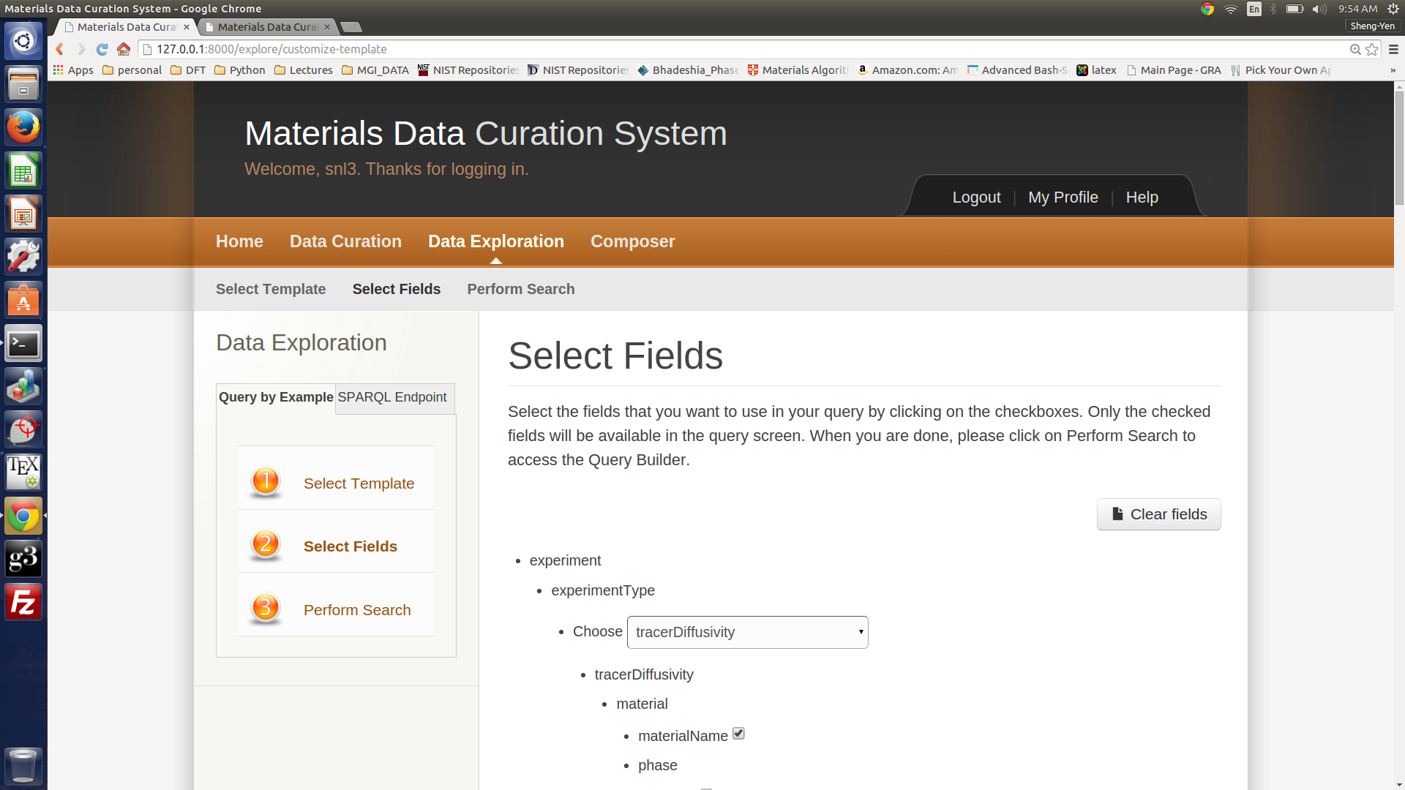
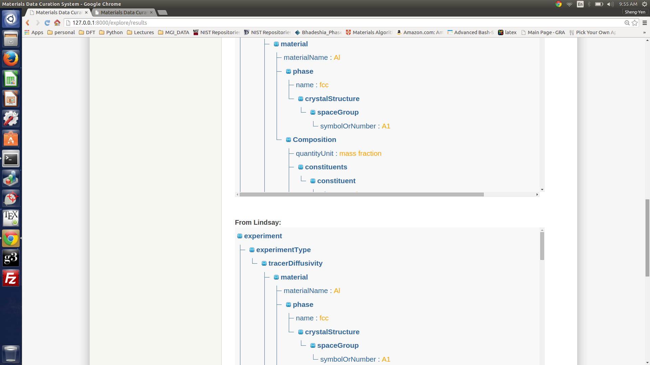
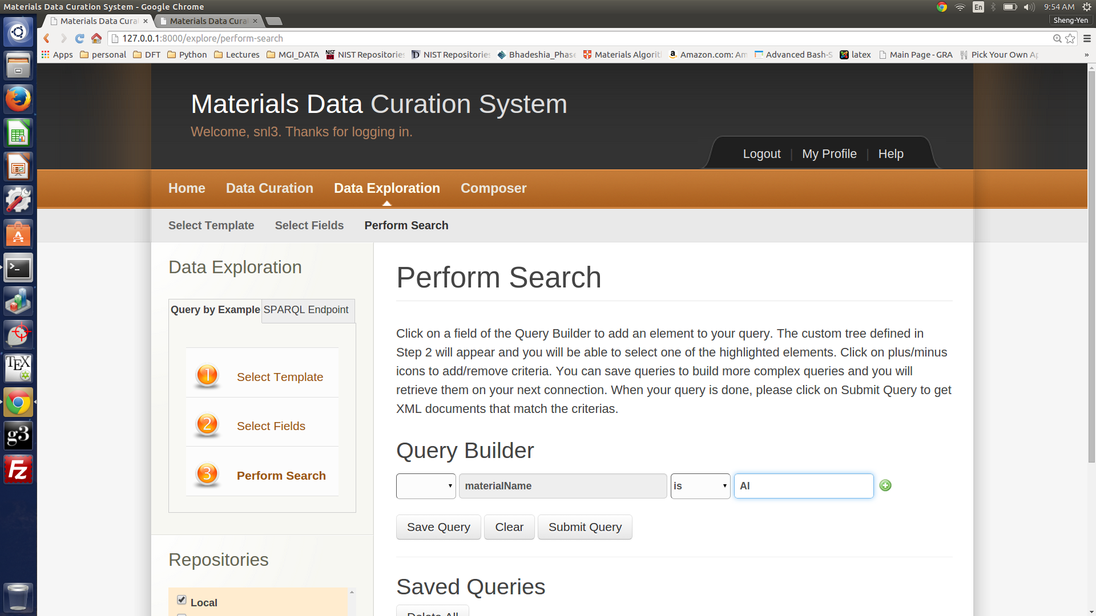
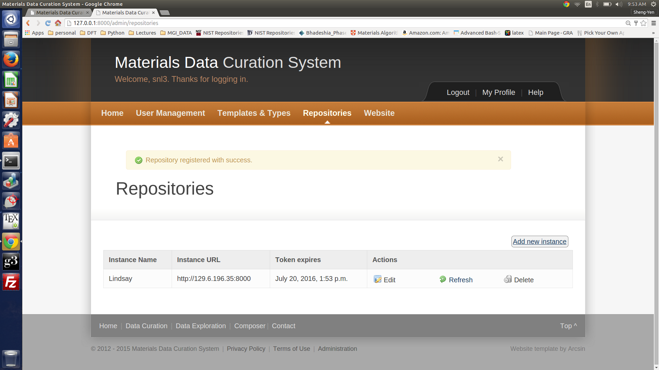
Shengyen’s data
Lindsay’s data

Slide 24
Materials Resource Registry
Find Resource
Data to Share with others
Materials Data Facility
Data to Share with others
Materials Common/ PRISMS
ASM/Computational Data Network
Materials Project
OQMD
MDC1
MDC2
MDC3
Dspace Repositories
MDC…
TRC
Others ….
Interatomic Potentials
Arrows indicate the flow of metadata
Notes:
How does this all fit together???

Slide 25
MDCS
Current features
Data Curation: Web interface or API
Small and large data formats
Data Exploration
“Template/Schema” Composer
Under development
Exporter tools
Data review
Collaborations need to build materials data “ecosystems”

Slide 26

More Info
Materials Data Repositories
https://materialsdata.nist.gov/
http://www.ctcms.nist.gov/potentials/
Data Curation Tools
https://github.com/usnistgov/MDCS
http://trc.nist.gov/GDC.html
NIST/MGI www.nist.gov/mgi

